Slide 1




DBMS PROJECT DEFENSE · 2026–2027
Courier Parcel Booking & Tracking Management System
Design and Implementation of a Database Management System
Dara Keerthana(25WU0102125)
PROGRAM · B.Tech
BRANCH · AI & ML
YEAR · II Year
COURSE · Database Management Systems
Woxsen University, Hyderabad
Academic Year 2026–2027
Notes:
1

Slide 2

01 · INTRODUCTION
A web-based DBMS for every parcel's journey
13
The Courier Parcel Booking and Tracking Management System is a web application that manages courier operations end to end — from booking a parcel to confirming its delivery.
  Centralized storage of all courier data
  Relational structure across 13 linked tables
  Unique tracking number for every parcel
  Bookings, scans, deliveries and payments in one place
  Accurate records with enforced data integrity
relational tables powering one centralized courier database
Notes:
2

Slide 3

02 · PROBLEM STATEMENT
Manual courier records break down at scale
01
Manual record maintenance is slow and error-prone
02
Data scattered across registers and files
03
Tracking a parcel is complex and time-consuming
04
Delivery attempts are not recorded properly
05
Reports and summaries are hard to generate
PROPOSED SOLUTION
A centralized relational database that manages the entire parcel lifecycle — from booking to delivery.
Notes:
3

Slide 4

03 · OBJECTIVES
What this project sets out to achieve
  Design a well-structured relational database
  Manage customer records efficiently
  Handle parcel details and unique tracking
  Process parcel bookings across branches
  Record deliveries and delivery attempts
  Calculate charges and track payments
  Perform SQL query operations on live data
  Maintain data integrity with constraints
  Provide a user-friendly web interface
Notes:
4

Slide 5


04 · SYSTEM ARCHITECTURE
Three tiers, one clean data flow
USER INTERFACE
Web pages built with HTML5, CSS3 and JavaScript for booking, tracking and reports
FLASK BACKEND
Python application logic handles routes, forms, validation and SQL queries
SQLITE DATABASE
courier.db with 13 relational tables linked by primary and foreign keys
TECHNOLOGY STACK
HTML5 · CSS3 · JavaScript · Python · Flask · SQLite · Replit · GitHub
Notes:
5

Slide 6
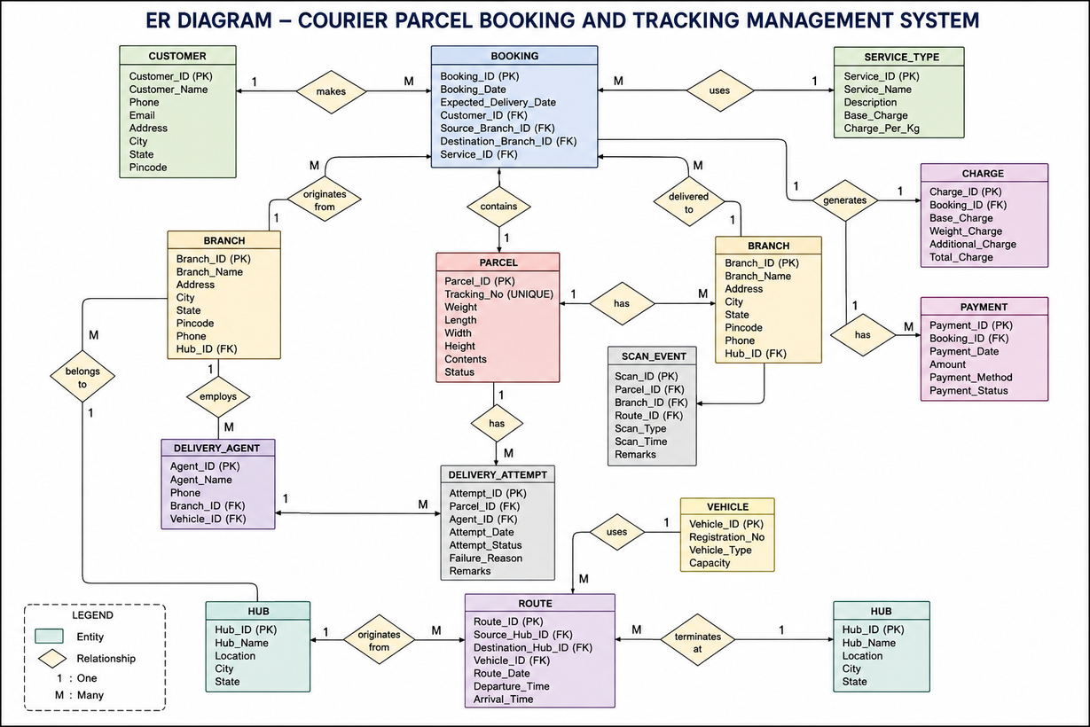
05 · ER DIAGRAM
13 entities, one connected parcel story
Notes:
6

Slide 7

06 · RELATIONAL SCHEMA & NORMALIZATION
Normalized to 3NF, keyed for consistency
1NF — atomic values, no repeating groups
2NF — every attribute depends on the whole primary key
3NF — no transitive dependencies; each fact stored once
Result: less redundancy, stronger integrity and consistent data
CUSTOMER (customer_id PK, name, phone UNIQUE, email, address)
BOOKING (booking_id PK, customer_id FK, branch_id FK, service_type_id FK, booking_date)
PARCEL (parcel_id PK, booking_id FK, tracking_no UNIQUE, weight, status)
PAYMENT (payment_id PK, charge_id FK, amount, mode, paid_on)
Notes:
7

Slide 8

07 · DATABASE DESIGN & SQL
Inside courier.db
13 tables 50 customers 120 parcels 120 bookings 300+ scan events
Sample data loaded across all tables for realistic testing of queries and reports
SQL OPERATIONS
INTEGRITY CONSTRAINTS
CREATE · INSERT · SELECT
UPDATE · DELETE · JOIN
  PRIMARY KEY and FOREIGN KEY links
  NOT NULL for required fields
  UNIQUE tracking numbers
  CHECK on weight, amount, status
  AUTOINCREMENT identifiers
Notes:
8

Slide 9

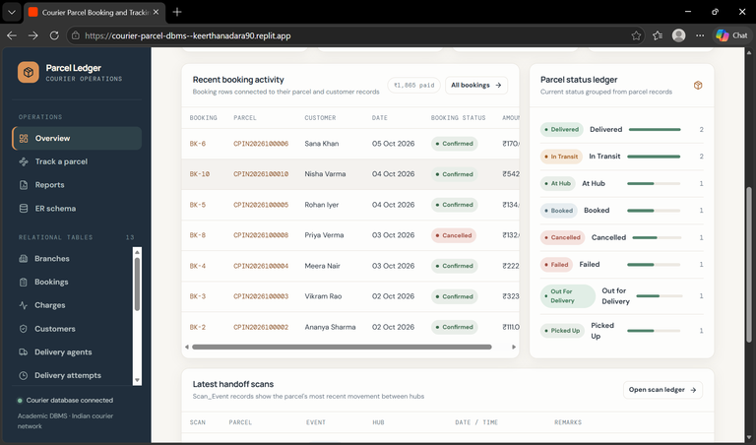
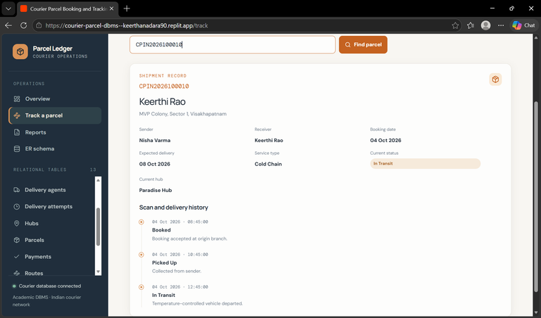
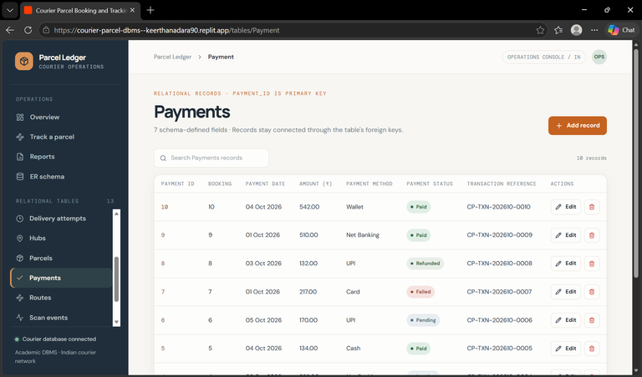
08 · KEY QUERIES & OUTPUTS
Queries that answer real questions
-- Booking details
SELECT b.booking_id, c.name, p.tracking_no, s.name
FROM booking b
JOIN customer c ON b.customer_id = c.customer_id
JOIN parcel p ON p.booking_id = b.booking_id
JOIN service_type s ON b.service_type_id = s.service_type_id;
-- Parcel tracking history
SELECT p.tracking_no, e.status, h.hub_name, e.scan_time
FROM scan_event e
JOIN parcel p ON e.parcel_id = p.parcel_id
JOIN hub h ON e.hub_id = h.hub_id
WHERE p.tracking_no = 'CPX1024' ORDER BY e.scan_time;
Live outputs: booking details · parcel tracking history · payment summary
Notes:
9

Slide 10

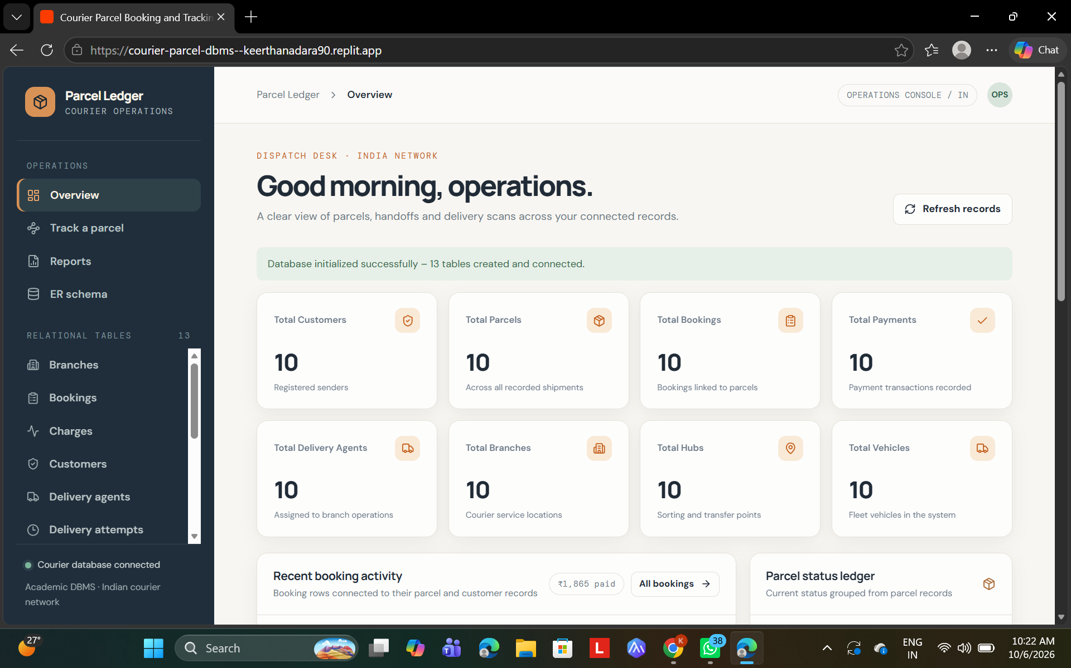
09 · USER INTERFACE & FEATURES
Full CRUD, one friendly web app
  Dashboard with live summary
  Customer management
  Parcel management
  Booking management
  Parcel tracking by number
  Delivery attempts
  Reports
  Charges and payments
  Create, read, update, delete
Notes:
10

